Slide 1
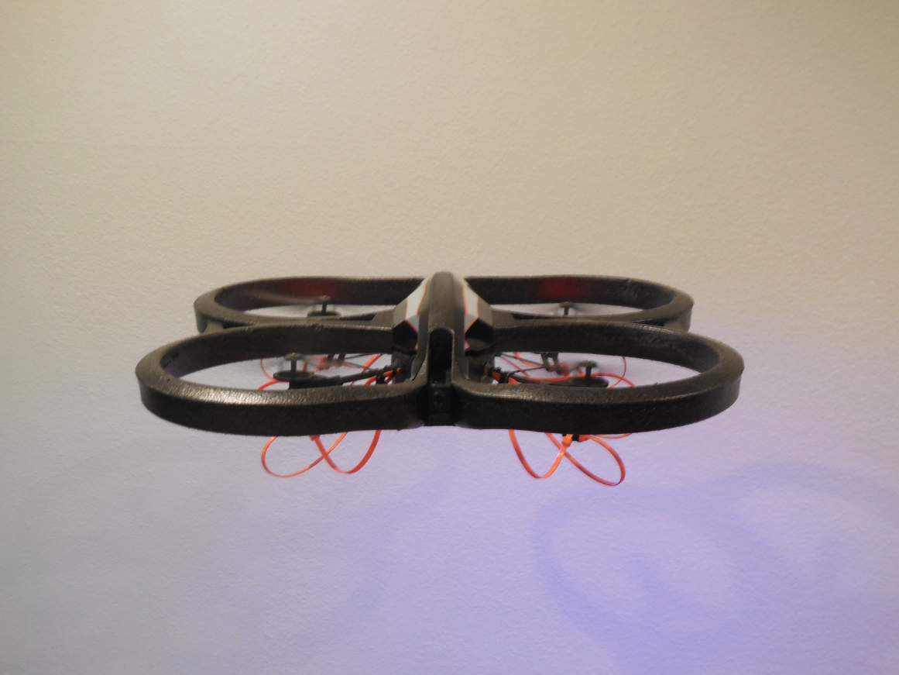
HAWKS (Hovering Aerocraft With Kinetic-Motion Sensing)
Hawkers: Eric Chiang,
A-Tion Zhuo Li, Amy Lin, Byron Lutz, Junda Zhu
Notes:
8 minutes!

Slide 2
HAWKS
Drone Movement
Cross Device Communication
Android Application
Amy Lin
Eric Chiang
Byron Lutz
Junda Zhu
A-Tion Zhuo Li

Slide 3
Responsibility: Eric Chiang
Major Involvement:
- Project idea
- Project management
Technical Involvement:
- Project Architecture
- Technology choice
- Drone control programming

Slide 4
Responsibility: Amy Lin
Major Involvement:
- Midpoint Presentation
Technical Involvement:
- Sending data from the Android
Application to the PC via Bluetooth
- Sending received data to the drone
program (both running on the PC) via
sockets

Slide 5
Responsibility: A-Tion Zhuo Li
Involvement:
-Android Application
- Processing data from Gyroscope
- Algorithms to translate data to commands
- Button Functionality
- Basic Layout
- Extra Feature: Flip

Slide 6
Responsibility: Byron Lutz
Major Involvement:
- Final report
Technical Involvement:
- Worked on retrieving sensor data from
the Android device
- Worked on application UI

Slide 7
Responsibility: Junda Zhu
Major Involvement:
Android Side Base Model Design
logo & basic UI
Accelerometer interface implementation & testing
acquiring sensor output from Android system
noise stripping by experiments, to determine what
threshold value to set for meaningful data
algorithms to transform sensor data into commands
- 1. directly through acceleration readings
- 2. calculate the change in accelerations readings

Slide 8
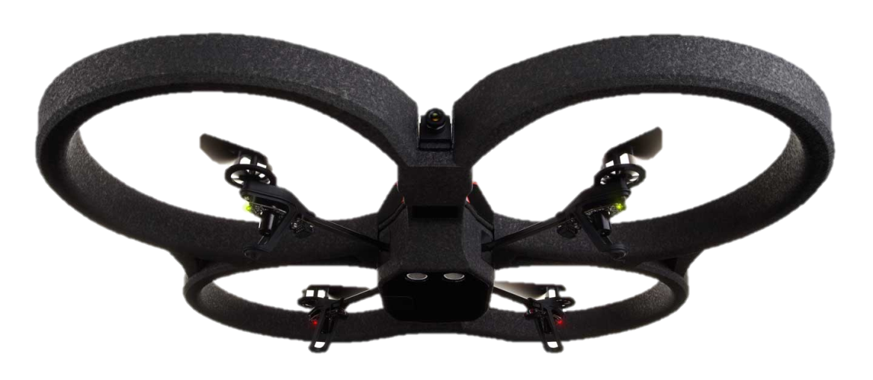
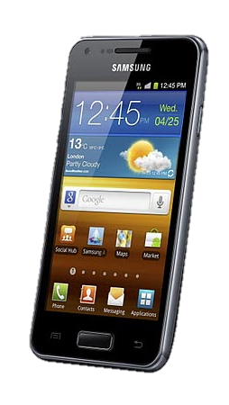
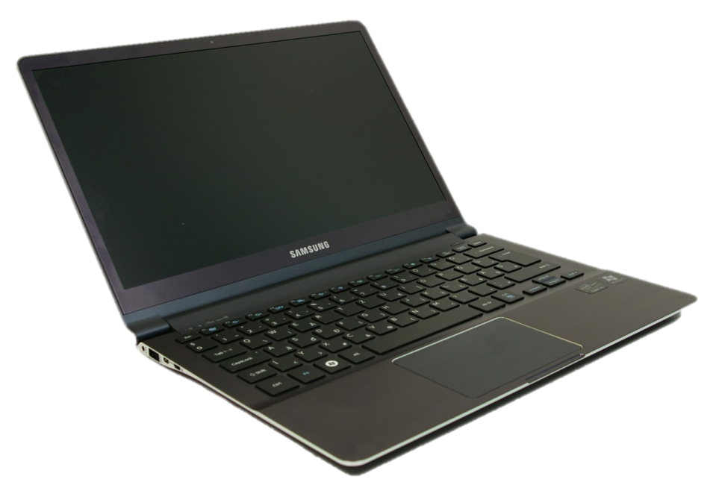

Architecture Overview
1. Gesture capture with Android phone’s: Gyroscope + Accelerometer
4. Node js server polls from socket + sends command via wifi
3. Client Java App receives + process + sends command to Server socket
2. Phone sends info over Bluetooth to laptop

Slide 9
Technology Overview
- Android Phone
- Gyroscope
- Accelerometer
- Bluetooth
- Wifi
- NodeJS

Slide 10
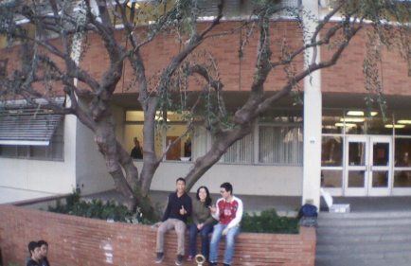
Questions?

Slide 11
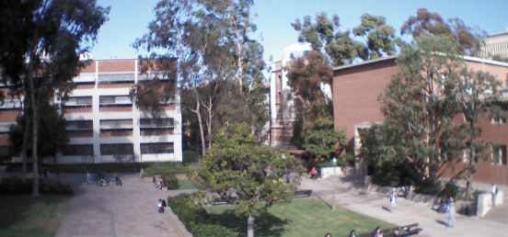

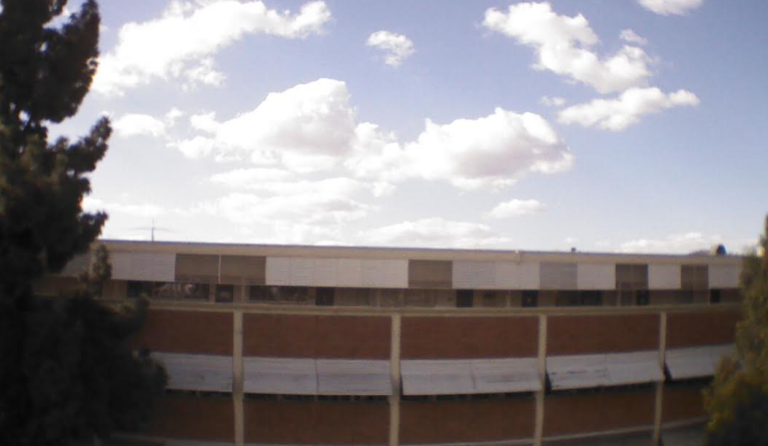
Photo Gallery

